Slide 1
Computer Organization & Design 实验与课程设计
Computer Organization & Design
lab5
CPU design-data path

Slide 2
Course Outline
Environment
Task
Principles
Implementation
Notes:
Rudimentary logic functions=基本的逻辑函数

Slide 3
Goal
1. Register transfer control usage
2. Master the key of CPU：data path principles
3. Design data path
4. Learn test case design
5. Learn test program design

Slide 4
Environment
Setup
1. Computer（Intel Core i5，4GB memory）
2. Spartan-3 Starter Kit Board/Sword
3. Xilinx ISE14.4

Slide 5
Course Outline
Environment
Task
Principles
Implementation
Notes:
Rudimentary logic functions=基本的逻辑函数

Slide 6
Task
1. Design data path supporting 9⁺ instructions
Implement data path using schematic design
ALU and Regs use modules of Exp04
Substitute the datapath core in Exp04
Implement based on Exp04
2. Design tests for datapath:
Unit test：ALU、Register Files
Datapath test：I-format、R-format

Slide 7
Course Outline
Environment
Task
Principles
Implementation
Notes:
Rudimentary logic functions=基本的逻辑函数

Slide 8
CPU organization
Digital circuit
General circuits that controls logical event with logical gates --Hardware
Computer organization
Special circuits that processes logical action with instructions -Software
Data input
Control unit
Control signals
Datapath
Data output
Status input
Status signals
Control output

Slide 9
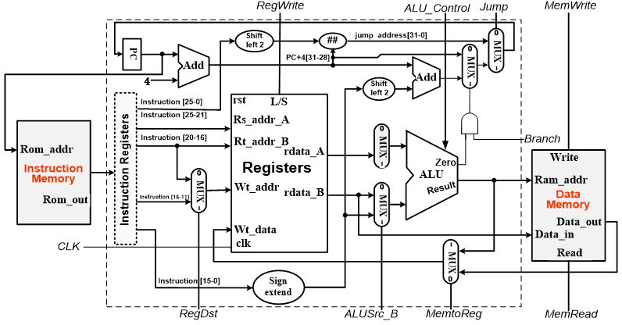
Datapath Stucture for simple implementation of CPU
Find paths for 9 instructions：5 MUX

Slide 10
Control signals
通路与操作控制
信号 | 源数目 | 功能定义 | 赋值0时动作 | 赋值1时动作
ALUSrc_B | 2 | Choice for B port of ALU | choose register B | Choose 32-bits immediate（after extension）
RegDst | 2 | Choice for write address for register | 选择指令rt域 | 选择指令rs域
MemtoReg | 2 | Choice for register write-data | 选择存储器数据 | 选择ALU输出
Branch | 2 | Choose beq target address | 选择PC+4地址 | 选择转移地址（Zero=1）
Jump | 2 | Choose jump target address | 选择J目标地址 | 由Branch决定输出
RegWrite | - | Register write control | 禁止寄存器写 | 使能寄存器写
MemWrite | - | Memory write control | 禁止存储器写 | 使能存储器写
MemRead | - | Memory read control | 禁止存储器读 | 使能存储器读
ALU_Control | 000- 111 | 3-bits ALU control | 参考表 Lab4 | Lab4
Please fill in the corresponding operation

Slide 11
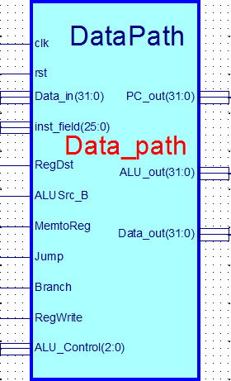
Data_path
Data_path
Main part of CPU
Object for register transfer control: general data path
Function:
Arithmetic logic unit
GPR
Paths for general counting
interface- Data_path
Interface signals are as right figure
Symbol file：Data_path.sym

Slide 12
Data_path.v
module Data_path( input clk, //寄存器时钟
input rst, //寄存器复位
input[25:0]inst_field, //指令数据域
input RegDst, //Regs目的地址控制
input ALUSrc_B, //ALU端口B输入选择
input MemtoReg, //Regs写入数据源控制
input Jump, //J指令
input Branch, //Beq指令
input RegWrite, //寄存器写信号
input[31:0]Data_in, // 存储器输入
input[2:0]ALU_Control, //ALU操作控制
output[31:0]ALU_out, //ALU运算输出
output[31:0]Data_out, //CPU数据输出
output[31:0]PC_out //PC指针输出
);
endmodule

Slide 13
Course Outline
Environment
Task
Principles
Implementation
Notes:
Rudimentary logic functions=基本的逻辑函数

Slide 14
Data Path design for CPU
-call mux of lab1
-call basic operating modules of lab1
-call ALU and Regs of lab4

Slide 15
Project：OExp05-Datapath
Design CPU data path
Implement data paths for 9+ instructions
Simulation and test for DataPath modules
Substitute datapath core
Substitute Data_Path.ngc of Exp04
Top level is the same as Exp04
name：Top_OExp05_DataPath.sch
Test
Design testing program(MIPS assembly program) to test：
ALU functions
I-format instructions
R-format instructions

Slide 16
设计要点
Copy the following symbol files to current project：
and32、or32、ADC32、xor32、nor32、srl32、 SignalExt_32、mux8to1_32、or_bit_32
add_32、 mux2to1_32 、 mux2to1_5、
ALU、Regs、Ext_32、REG32

Slide 17
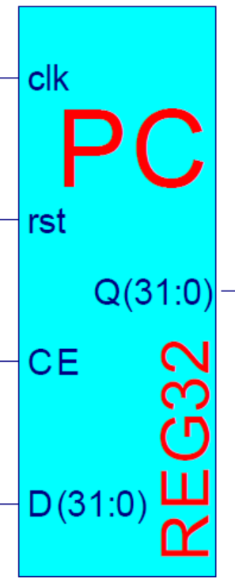
设计要点
Implement 32-bits register
usage：PC、data、address or instruction storage
Use behavioral description, refer to logic lab Exp10，
Module name：REG32
Positive-edge：clk
enabling：CE
Synchronous reset ：rst=1
Data input：D(31:0)
Data output：Q(31:0)
Description reference
module REG32(input clk,
……
always @(posedge clk or posedge rst)
if (rst==？) Q <= ？;
else if (？) Q <= ？;
endmodule
Module symbol

Slide 18
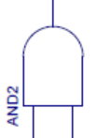
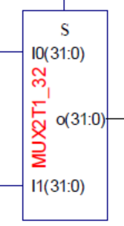
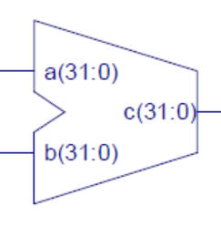
Create schematic input template for DataPath
Implement PC datapath
Call REG32、add_32、AND2 and MUX2T1_32 modules
design：
execute (PC+4)、PC of Jump and Beq instructions in order
Calculation and paths
Notice that implementation of immediates
“4” = ？？？？
Branch_offset = ？？？？
Jump_addr = ？？？？

Slide 19
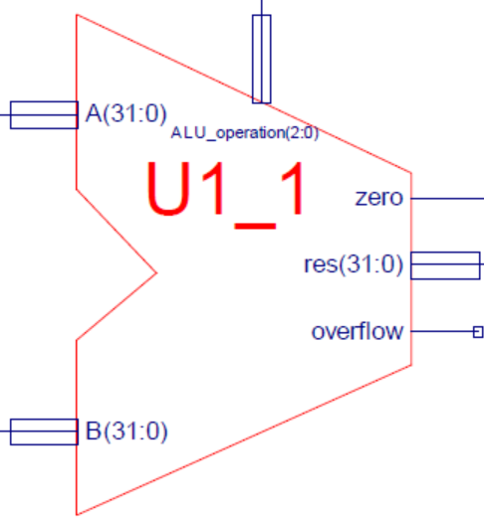
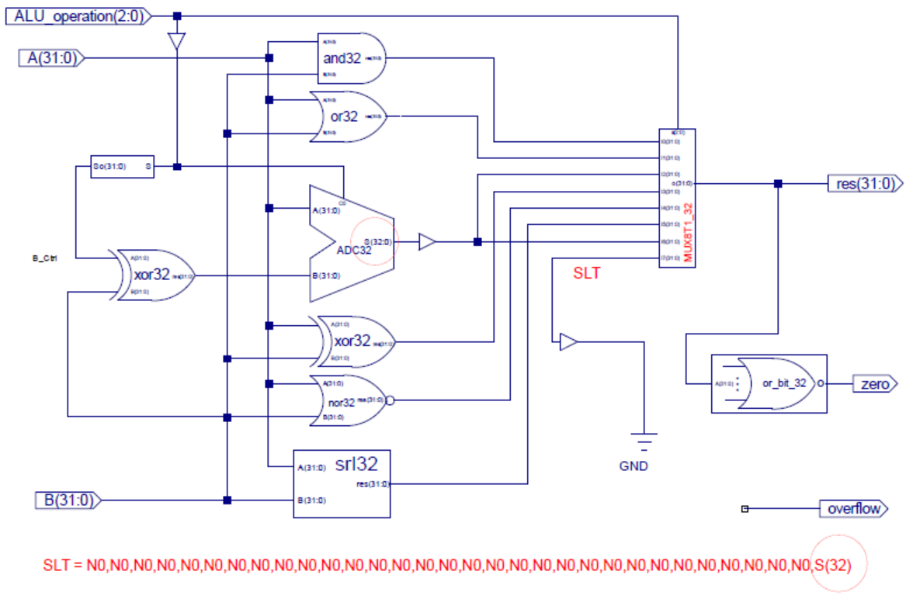
Call ALU module of Exp04
信号扩展模块

Slide 20
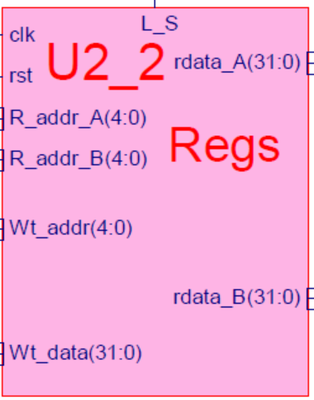
Call Regs module of Exp04
There is BUG in this code，debug yourself
Module regs(input clk, rst, L_S,
input [4:0] R_addr_A, R_addr_B, Wt_addr,
input [31:0] wt_data
output [31:0] rdata_A, rdata_B
);
reg [31:0] register [1:31]; // r1 - r31
integer i;
assign rdata_A = (Rs_addr_A == 0) ? 0 : register[reg_Rd_addr_A]; // read
assign rdata_B = (Rt_addr_B == 0) ? 0 : register[reg_Rt_addr_B]; // read
always @(posedge clk or posedge rst)
begin if (rst==1) for (i=1; i<32; i=i+1) register[i] <= 0; // reset
else if ((Rd_addr != 0) && (we == 1))
register[Wt_addr] <= wdata; // write
end
endmodule

Slide 21
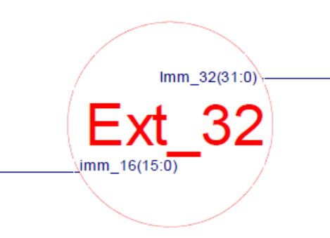
Design datapath for R-format and I-format instructions
Choose MUX
Regs datapath design
R-format source addresses：rs、rt
R-format destination address：rd
R-format destination data：form ALU
I-format source address：rs
I-format destination address：rt
I-format destination data：from Memory
What is the source address of Beq？
ALU datapath design
What is the choice for input A of ALU？
Input B of ALU
Call Ext_32 module
R-format：from Regs B input
I-format：Where from
What is address？
What is control signal

Slide 22
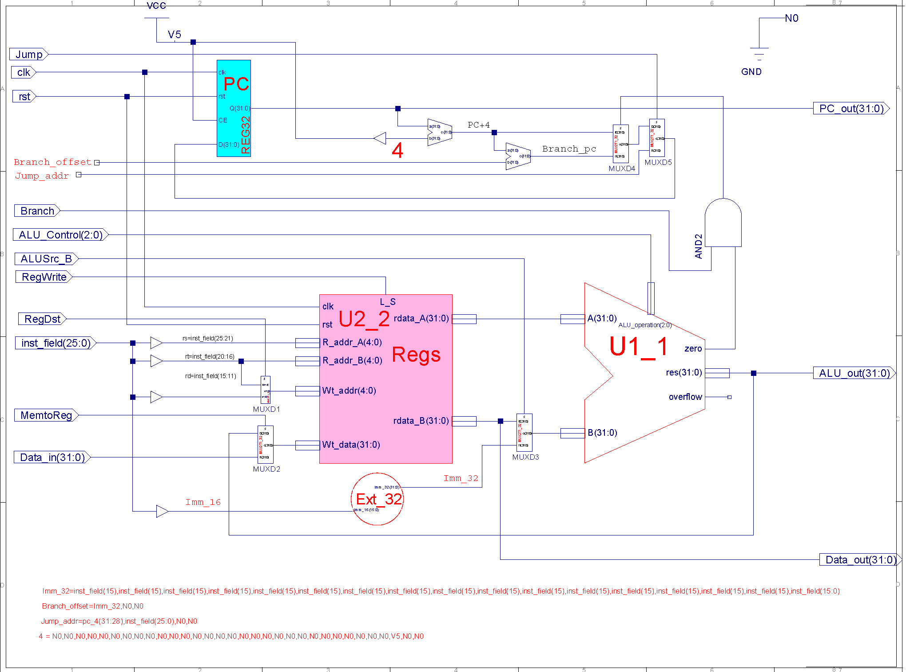
Schematic structure of data path
Not unique
PC计数器

Slide 23
Datapath simulation
DataPath simulation
Rules checking for schematic, do simulation if no Errors和warnings
Just function test, ignore performance
Datapath test
design 9 instructions that include all data paths
input：
Calculate the corresponding control signal and data value
clk、rst
ALU function test
design add、and、sub、or、nor、slt instructions
Calculate the corresponding control signal and data value
Use Beq、Load and Store instructions to test address calculation
Regs function test
Use add instruction to test each register

Slide 24
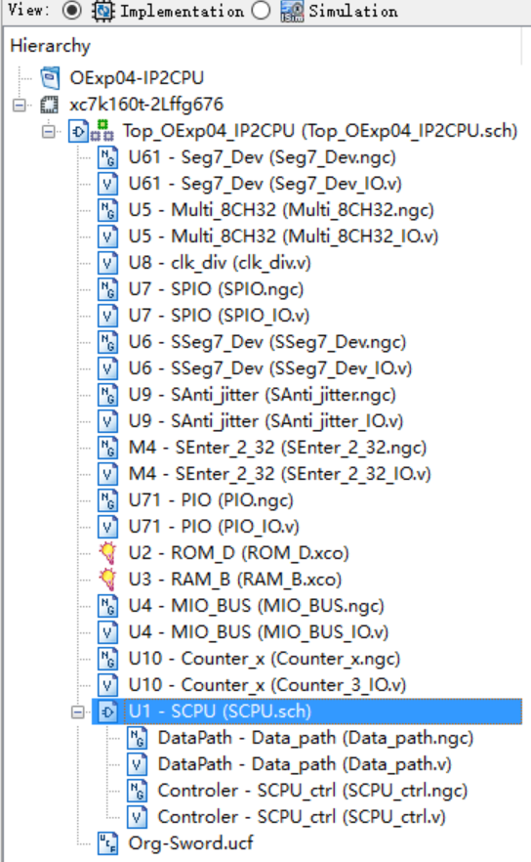
DataPath substitution
substitution
Substitute the datapath IP core of Exp04 after simulation correctly
Clear Exp04 project
Remove datapath IP cores from project
Delete core files:
Data_path.ngc and Data_path.v
In Project menu, run： Cleanup Project Files …
Rebuild Exp04 project
without Data_path.ngc core
To be removed

Slide 25
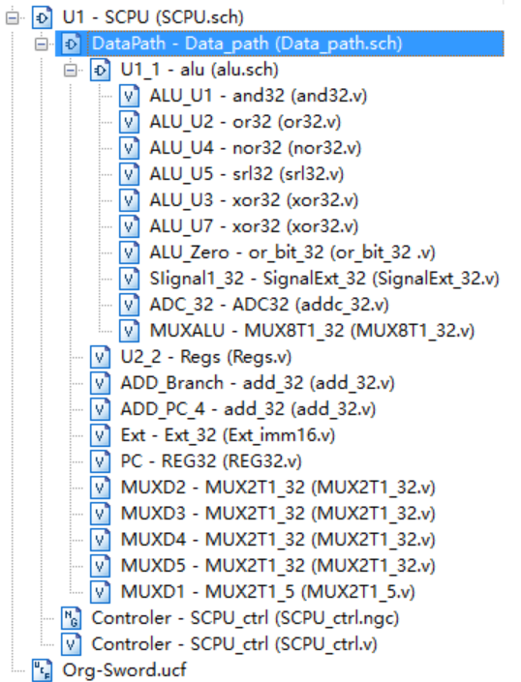
Project structure after substitute DapaPath IP core
Modules relation after datapath substitution for Exp05
PC designed in this lab
Controller unchanged, still use IP core

Slide 26
Verification
Use DEMO program to test datapath
DEMO interface
SW[7:5]=000， SW[2]=0(high speed CPU clock)
SW[4:3]=00， SW[0]=0，点阵显示程序：跑马灯
SW[4:3]=00， SW[0]=0，点阵显示程序：矩形变幻
SW[4:3]=01， SW[0]=1，内存数据显示程序：0～F
SW[4:3]=10， SW[0]=1，当前寄存器R9+1显示
Use assembly program to test
Test ALU function
Test Regs addressing
Test datapath for I-format instruction
Test datapath for R-format instruction

Slide 27
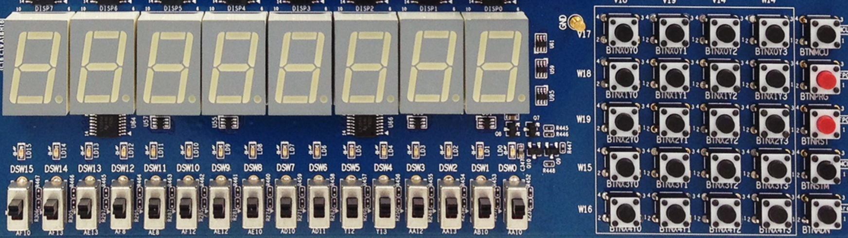
Verification-DEMO interface
Same as lab3
X₀Y₀
X₀Y₁
X₀Y₂
X₀Y₃
MCU3
0
1
2
3
X₁Y₀
X₁Y₁
X₁Y₂
X₁Y₃
PRGO
SEG3
SEG2
SEG1
SEG0
SEG3
SEG2
SEG1
SEG0
4
5
6
7
X₂Y₀
X₂Y₁
X₂Y₂
X₂Y₃
RSTN
LED15 LED14 LED13 LED12 LED11 LED10 LED9 LED8 LED7 LED6 LED5 LED4 LED3 LED2 LED1 LED0
8
9
A
B
X₃Y₀
X₃Y₁
X₃Y₂
X₃Y₃
MCU1~2
C
D
E
F
W15 SW14 SW13 SW12 SW11 SW10 SW9 SW8 SW7 SW6 SW5 SW4 SW3 SW2 SW1 SW0
X₄Y₀
X₄Y₁
X₄Y₂
X₄Y₃
Ardunio
SW[7:5]=choose datapath
SW[7:5]=000：output when CPU runs the program
SW[7:5]=001：PC word address
SW[7:5]=010：instruction word
SW[7:5]=011：counter
SW[7:5]=100：RAM address
SW[7:5]=101：CPU data output
SW[7:5]=110：CPU data input
SW[0]=text/graphics
SW[1]=upper/lower 16-bits
No use
SW[2]=CPU_clk
SW[4:3]=00，display bit-map：marquee
SW[4:3]=00，display bit-map：matrix transform
SW[4:3]=01，display memory data：0～F
SW[4:3]=10，display current reg+1

Slide 28
Test program reference：ALU and Regs
Use ALU and Regs test files to substitute DEMO
Observe the testing result by CPU output step by step
SW[7:5]=100, Addr_out=ALU output
SW[7:5]=101，Data_out=register B output
#baseAddr 0000
loop: nor r1,r0,r0; //r1=FFFFFFFF
slt r2,r0,r1; //r2=00000001
add r3,r2,r2; //r3=00000002
add r4,r3,r2; //r4=00000003
add r5,r4,r3; //r5=00000005
add r6,r5,r4; //r6=00000008
add r7,r6,r5; //r7=0000000d
add r8,r7,r6; //r8=00000015
add r9,r8,r7; //r9=00000022
add r10,r9,r8; //r10=00000037
add r11,r10,r9; //r11=00000059
add r12,r11,r10; //r12=00000090
add r13,r12,r11; //r13=000000E9
add r14,r13,r12; //r14=00000179
add r15,r14,r13; //r15=00000262
add r16,r15,r14; //r16=000003DB
add r17,r16,r15; //r17=000006D3
add r18,r17,r16; //r18=00000A18
add r19,r18,r17; //r19=000010EB
add r20,r19,r18; //r20=00001B03
add r21,r20,r19; //r21=00003bEE
add r22,r21,r20; //r22=000046F1
add r23,r22,r21; //r23=000080DF
add r24,r23,r22; //r24=0000C9D0
add r25,r24,r23; //r25=00014AAF
add r26,r25,r24; //r26=0001947F
add r27,r26,r25; //r27=0012DF2E
add r28,r27,r26; //r28=001473AD
add r29,r28,r27; //r29=002752DB
add r30,r29,r28; //r30=003BC688
add r31,r30,r29; //r31=00621963
j loop;

Slide 29
Test program reference
Design test program to substitute DEMO
Observe the testing result by CPU output step by step
Function of datapath is indicated by transferring data，e.g., immediate datapath：14+$zero
#baseAddr 0000
start: //the result of datapath is observed by reading the operands of the following instruction
lw r5, 14($zero); //testing constant 55555555。memory_read
start_A:
add r1, r5, $zero; //r1: register_write。R5:register_read output A
nor r2, $zero, r1; //r1: R5:register_read output B。R2:ALU output
lw r5, 48($zero); //testing constant: AAAAAAAA。immediate:00000048
beq r2, r5 start_A; //loop testing
j start; //loop testing。Immediate：00000014
Completeness of testing
The above tests only demonstrate the correctness of datapath switch and bus transfer
Other tests are required to try all possibilities for completeness

Slide 30
Test data memory module
Design data memory test file
Address of 7-seg display is E0000000/FFFFFFE0
Address of LED display is F0000000/FFFFFF00
Please design test file for memory
Testing results are shown on 7-seg display
RAM initialization is same asExp03
F0000000, 000002AB, 80000000, 0000003F, 00000001, FFF70000, 0000FFFF, 80000000, 00000000, 11111111, 22222222, 33333333, 44444444, 55555555, 66666666, 77777777, 88888888, 99999999, aaaaaaaa, bbbbbbbb, cccccccc, dddddddd, eeeeeeee, FFFFFFFF, 557EF7E0, D7BDFBD9, D7DBFDB9, DFCFFCFB, DFCFBFFF, F7F3DFFF, FFFFDF3D, FFFF9DB9, FFFFBCFB, DFCFFCFB, DFCFBFFF, D7DB9FFF, D7DBFDB9, D7BDFBD9, FFFF07E0, 007E0FFF, 03bdf020, 03def820, 08002300;

Slide 31
Design testing record form
Learn how to do statistics for experimental data
Record ALU和Regs testing results
Design record form yourself
Record datapath testing results
Design record form yourself
Record data memory testing results
Design record form yourself

Slide 32
Thinking
How to modify the datapath if we want to support more instructions as follows:：
R-Type： srl*, jr, jalr, eret*；
I-Type： addi, andi, ori, xori, lui, bne, slti
J-Type： Jal；
Do we need to modify the datapath design if we want to support more I-Type arithmetic instructions？

Slide 33
END

